Slide 1

ETOURNIFY
ESPORT MANAGEMENT PLATFORM
Designed by:
Bao Lam
Kainan Pan
Nathaniel Navarro

Slide 2





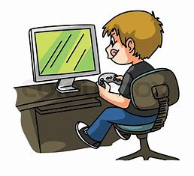
INTRODUCTION
Etournify is website-based platform created to help people access to latest gaming information around the world with convenience.
Recognizing the global need to connect people through their favorite games, our group created Etournify — a platform designed to bring gamers together for fun and competition.

Slide 3
PURPOSE
Our purpose is to create a platform for gamers to connect through organizable online tournaments. It brings the communities together by making gaming more inclusive and streamlined.
Users can also view post-event result, match schedule, making competitive gaming more accessible and organized

Slide 4

USER PERSONA
Name: Jane
Role: Semi-Pro Gamer
Needs:
Quick access to match data
Detailed performance breakdown
Pain Points:
Complex UI with inaccurate displayed stats
Lack of historical data
Goals:
Ability to watch match-ups
Analyze team/player performance on matches with ease

Slide 5
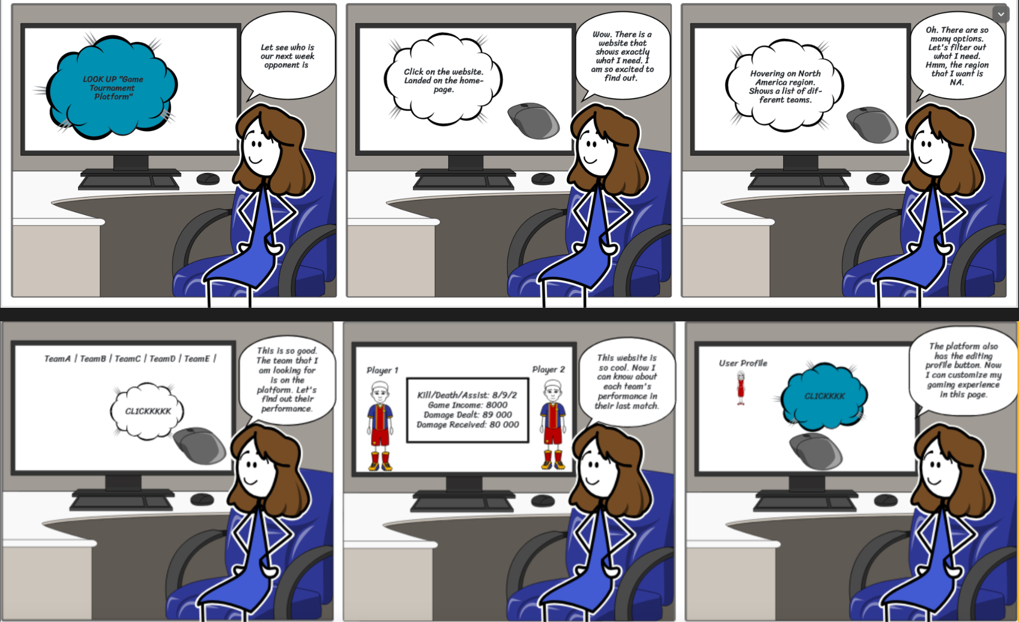
STORYBOARD

Slide 6
USER INTERVIEW
How challenging it is to navigate through this interface ?
_ The interface is logical with each function stays at the different page.
Are there any features that you expect to see ?
_ The platform should be personalized so that each user should have their own profile.
Do you have any suggestions for enhancing the usability of this design ?
_ The aesthetic can be enhanced with gaming theme background. Also more image and icon should be included to better reflecting the tournaments.

Slide 7
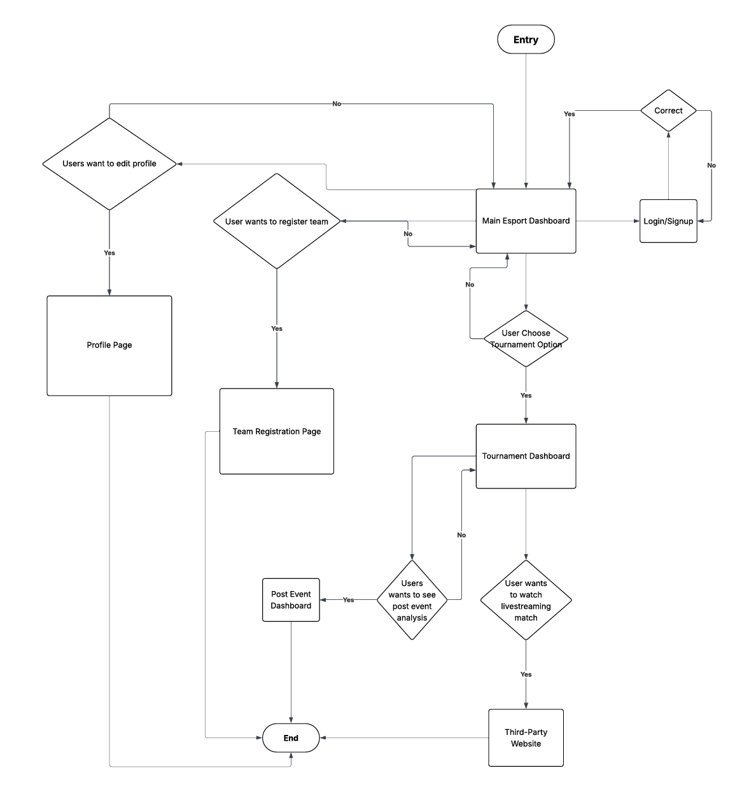
WIREFRAME

Slide 8
KEY FEATURES

Slide 9
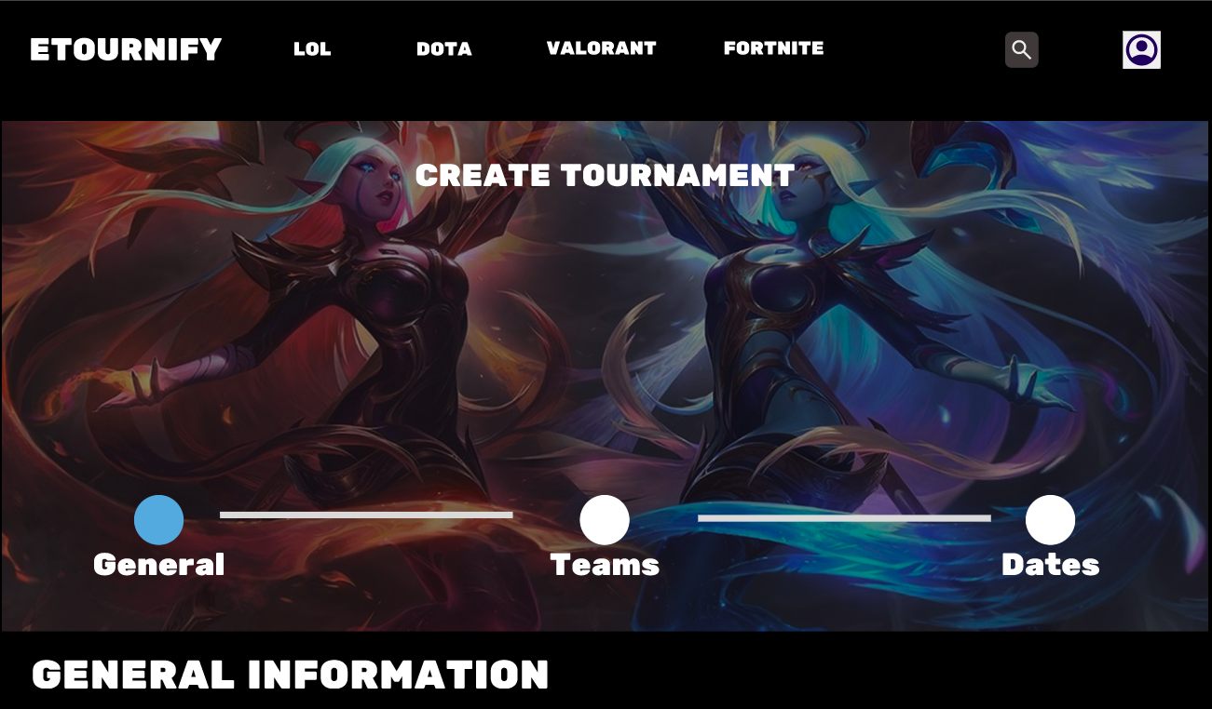
TOURNAMENT CREATION

Slide 10
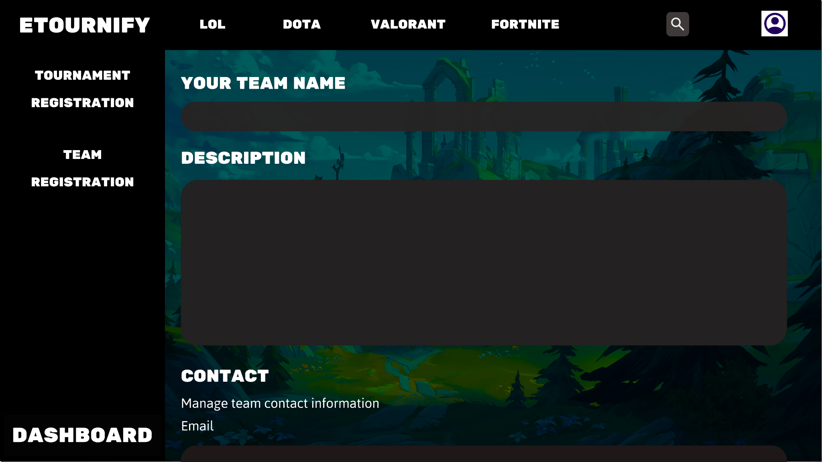
TEAM REGISTRATION

Slide 11
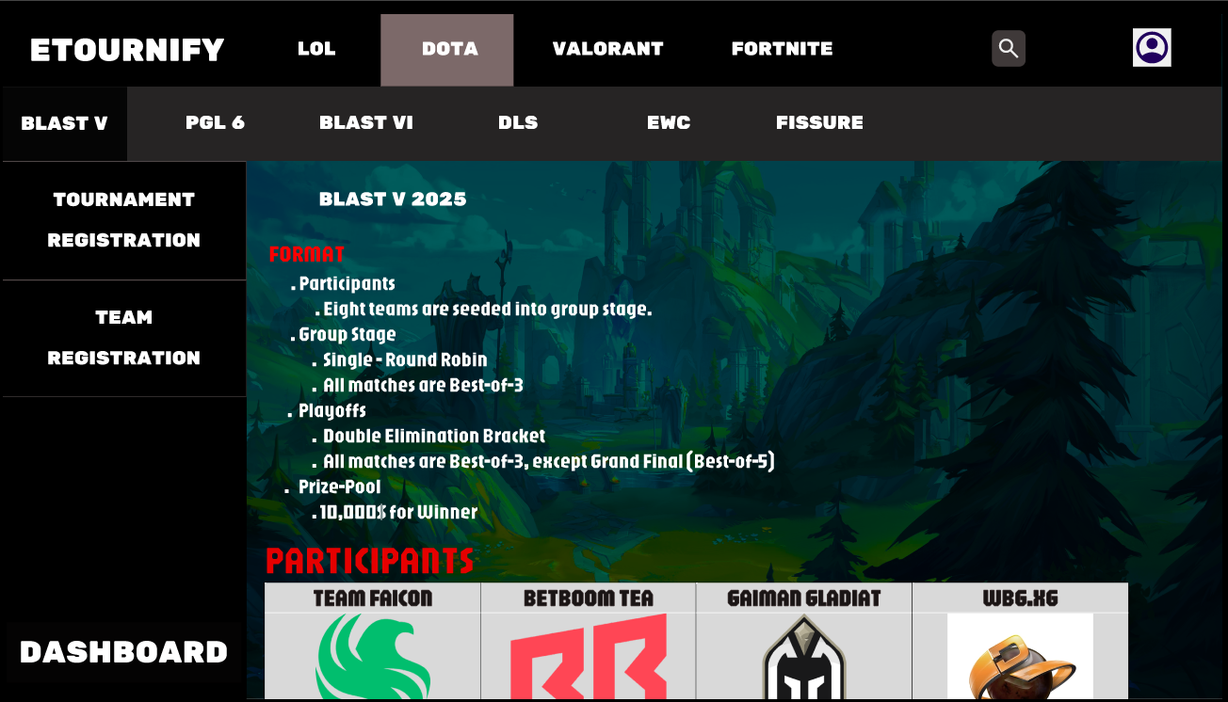
TOURNAMENT INFORMATION

Slide 12
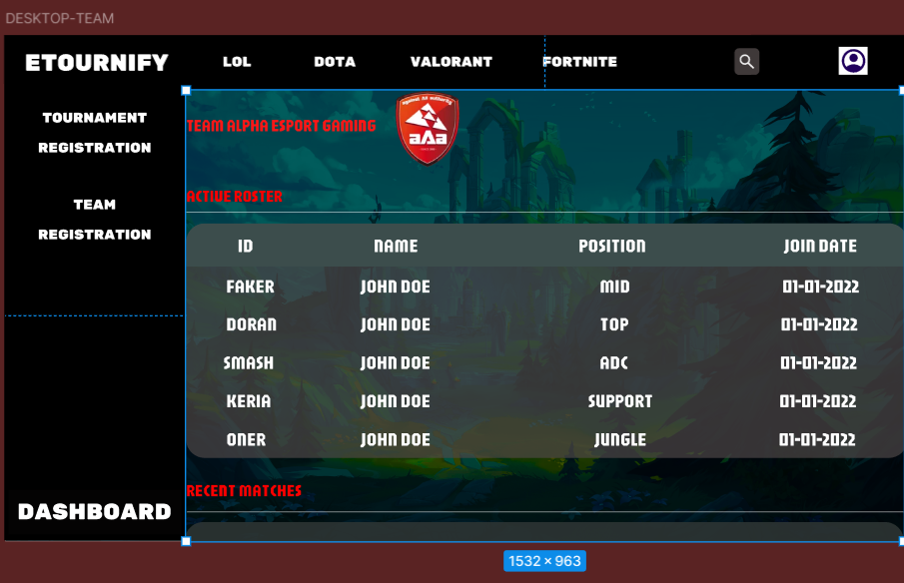
TEAM INFORMATION

Slide 13
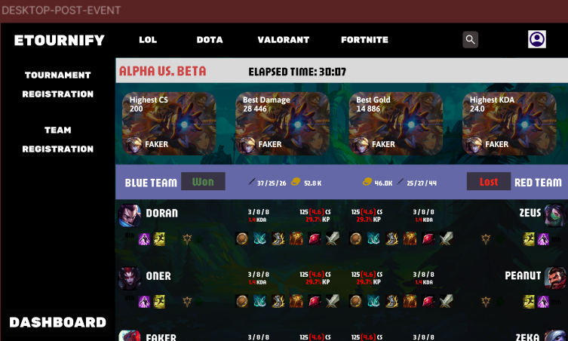
POST EVENT ANALYSIS

Slide 14
KEY CHALLENGES & LIMITATIONS
Limited Interactivity
Since this is a static prototype, we're a bit limited by what Figma can do in terms of interactions. We used clickable frames to show how users would move through things, but we couldn't really show certain dynamic features—like real-time updates, conditional logic, or live data inputs—fully.
Incomplete Feature Simulation
Some features, like post-match reports, tracking player stats, or customizing profiles, are shown visually but haven't been fully tested in terms of how users will actually interact with them. We’ll need to sort out their logic and flow further during development.

Slide 15
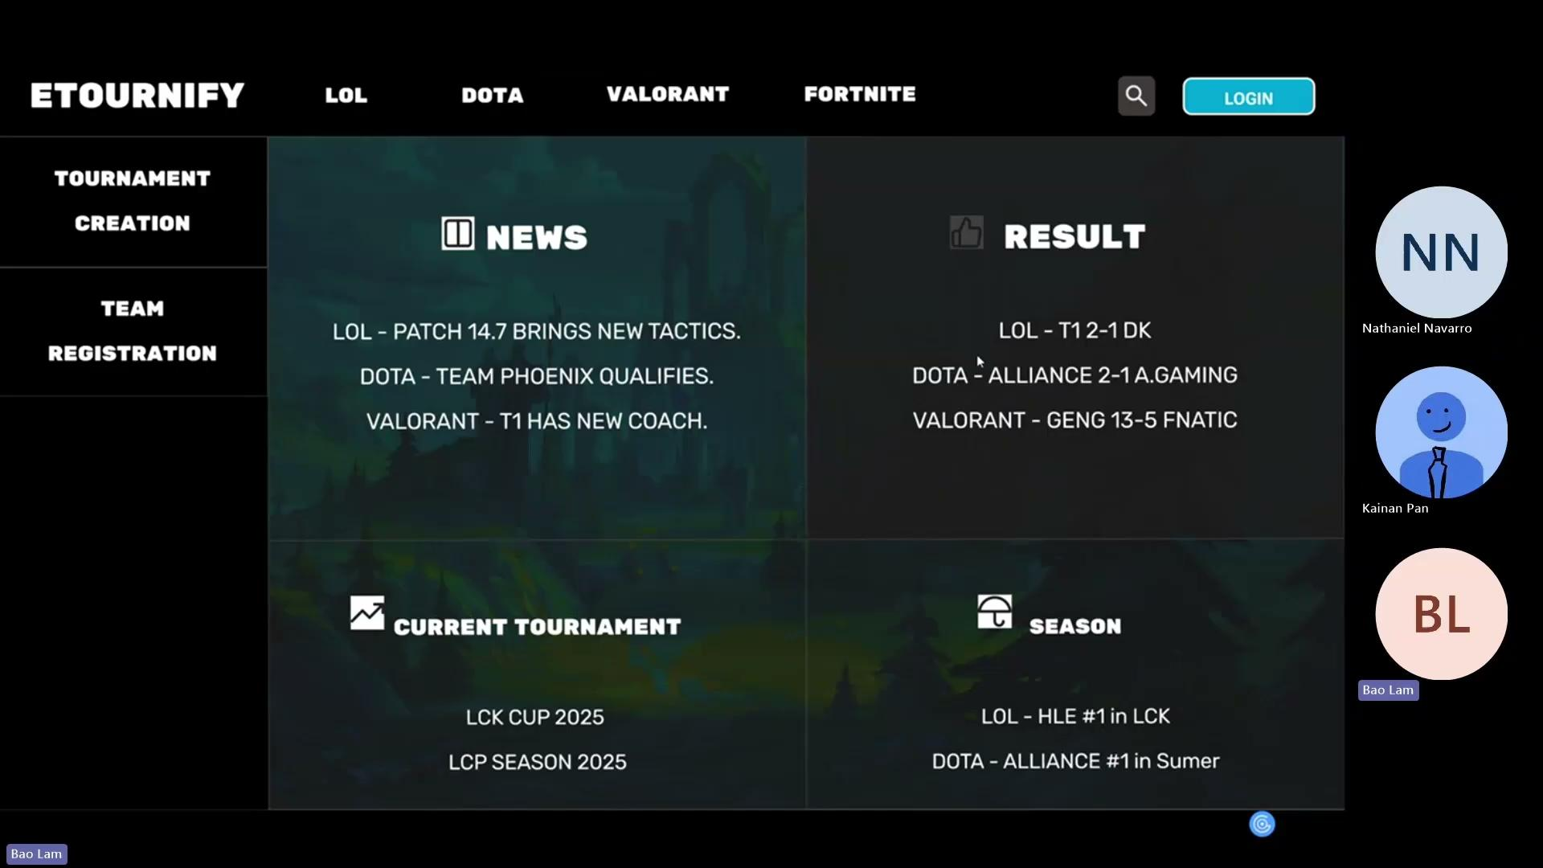
DEMO

Slide 16
THANK YOU

